Slide 1
MODULE 2
Systems Analysis Skills

Slide 2
Role of System Analyst
The system analyst is a person who is thoroughly aware of the system and guides the system development project by giving proper directions.
He is an expert having technical and interpersonal skills to carry out development tasks required at each phase.
Main Roles
Defining and understanding the requirement of user through various Fact finding techniques.
Prioritizing the requirements by obtaining user agreement.
Gathering the facts or information and acquires the opinions of users.
Maintains analysis and evaluation to arrive at appropriate system which is more user friendly.
Suggests many flexible alternative solutions, pick the best solution, and quantify cost and benefits.
Draw certain specifications which are easily understood by users and programmer in precise and detailed form.

Slide 3
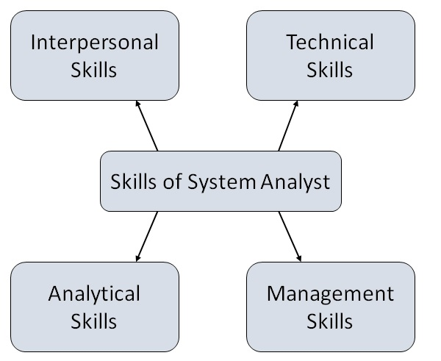
Attributes of a Systems Analyst
The following figure shows the attributes a systems analyst should possess

Slide 4
Attributes of a Systems Analyst
Interpersonal Skills
Interface with users and programmer.
Facilitate groups and lead smaller teams.
Managing expectations.
Good understanding, communication, selling and teaching abilities.
Motivator having the confidence to solve queries.
Analytical Skills
System study and organizational knowledge
Problem identification, problem analysis, and problem solving
Sound commonsense
Ability to access trade-off
Curiosity to learn about new organization

Slide 5
Attributes of a Systems Analyst
Management Skills
Understand users jargon and practices.
Resource & project management.
Change & risk management.
Understand the management functions thoroughly.
Technical Skills
Knowledge of computers and software.
Keep abreast of modern development.
Know of system design tools.
Breadth knowledge about new technologies.

